Slide 1
Alan Gabriel and MEDOC beginnings
Jean-Claude Vial
Institut d’Astrophysique Spatiale, Orsay

Slide 2
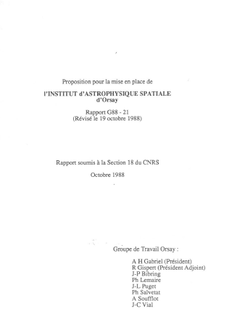
From creating I.A.S. to creating MEDOC a short (1988 – 1995) but eventful story
1988
1991

Slide 3
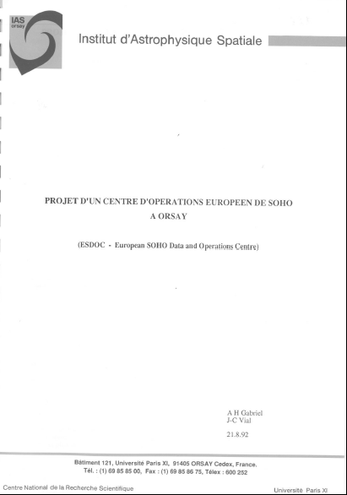
Be ready for an A.O. !

Slide 4
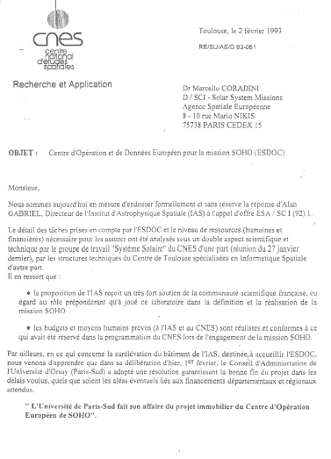
Submit …
Joint I.A.S.-C.N.E.S. proposal

Slide 5
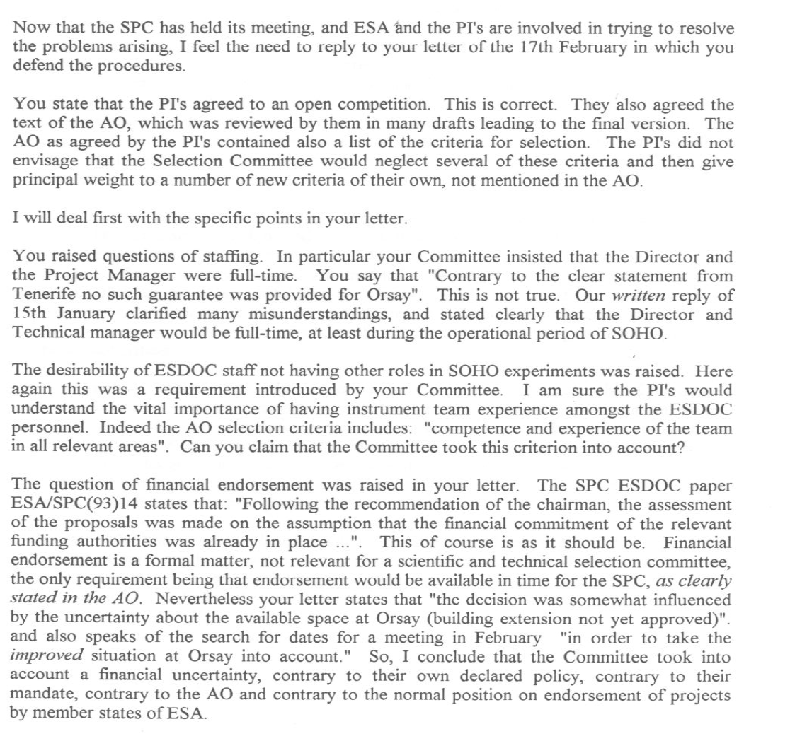
Submit and be not selected ! Letter to the chairman of the Selection Committee (1)

Slide 6
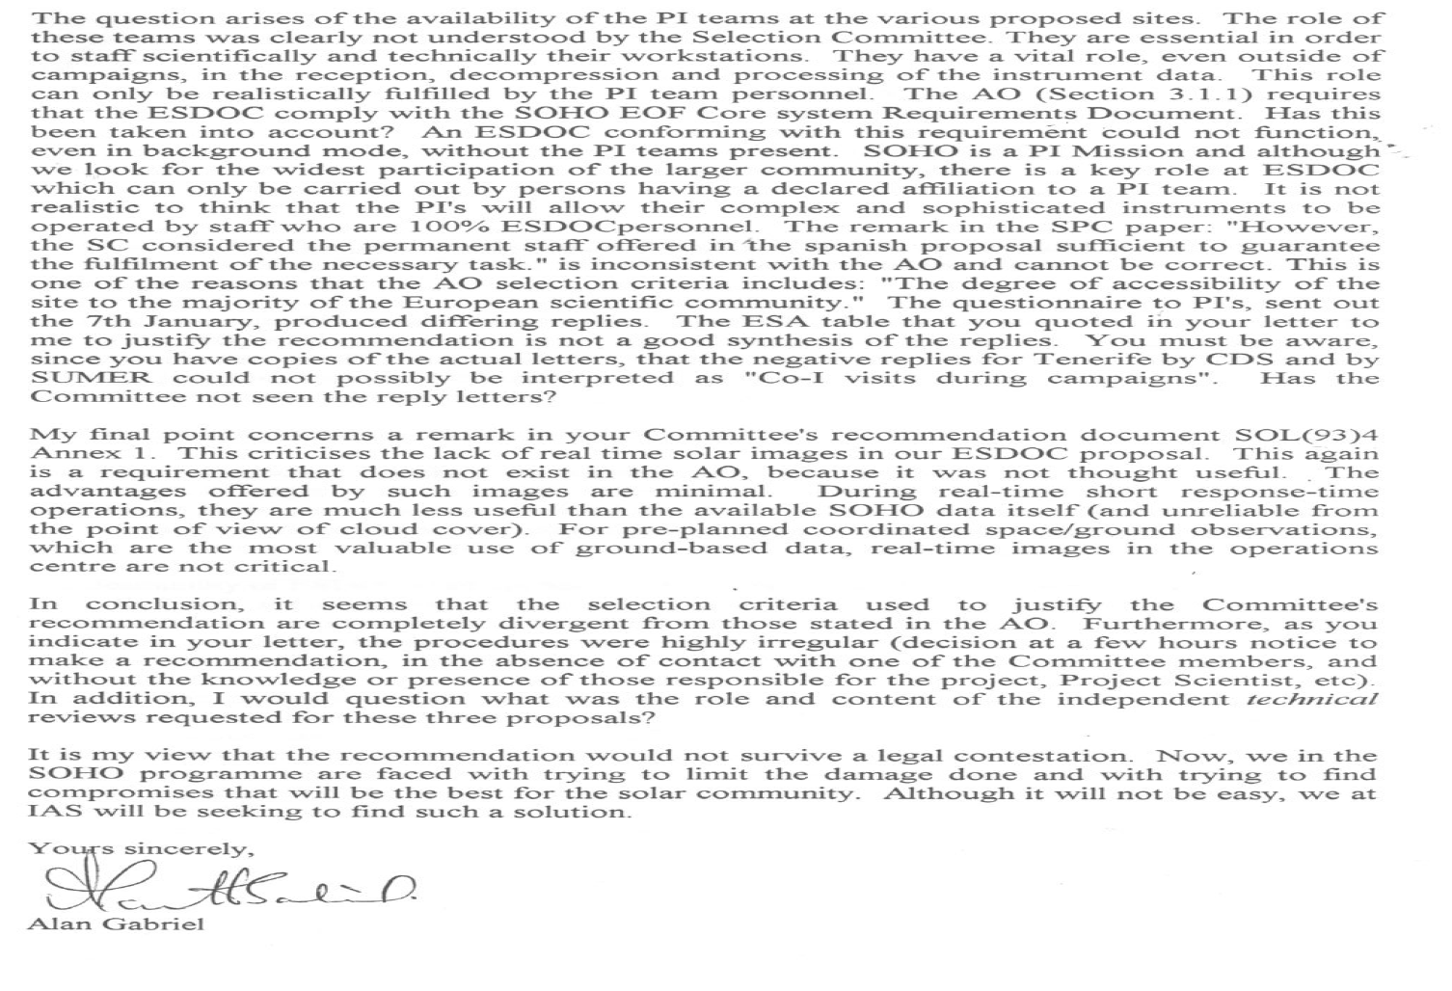
Submit and be not selected ! Letter to the chairman of the Selection Committee (2)

Slide 7
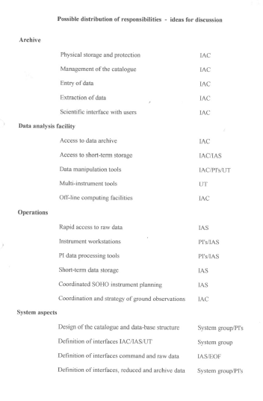
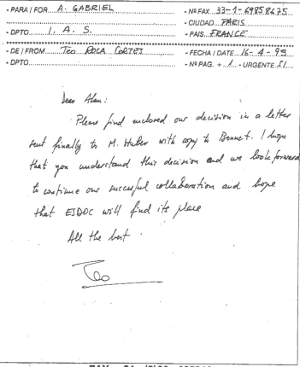
From ESDOC to MEDOC : various solutions (1)
With I.A.C. and Torino

Slide 8
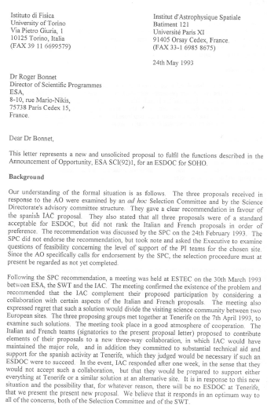
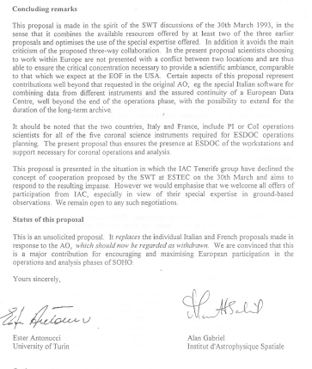
From ESDOC to MEDOC : various solutions (2)
With Torino

Slide 9
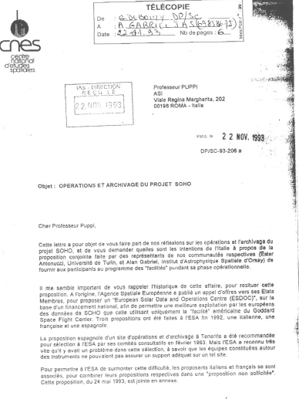
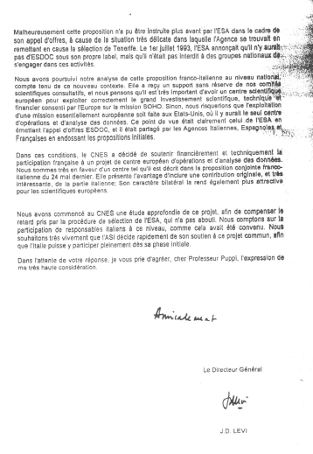
From ESDOC to MEDOC : various solutions (3)
With Torino : a solution that had the support of C.N.E.S

Slide 10
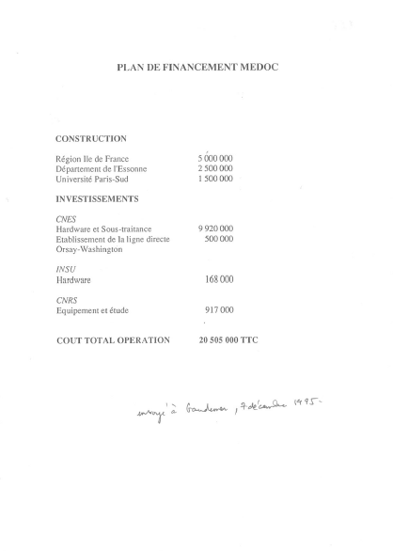
From ESDOC to MEDOC : a long road (1)
Essential contributions of :
Région Ile de France
Département Essonne
Université Paris-Sud : 1,5 MF prélevé sur le budget des autres laboratoires !
C.N.E.S.

Slide 11
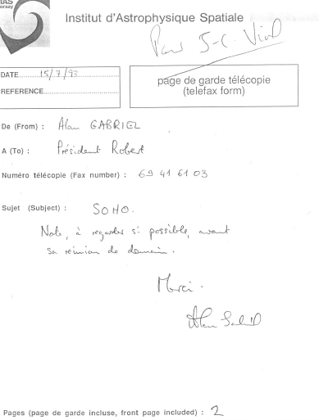
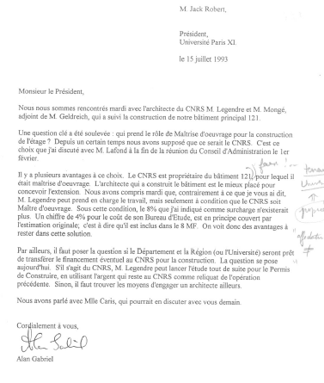
From ESDOC to MEDOC : a long road (2)
From the very beginning : the support of the University

Slide 12
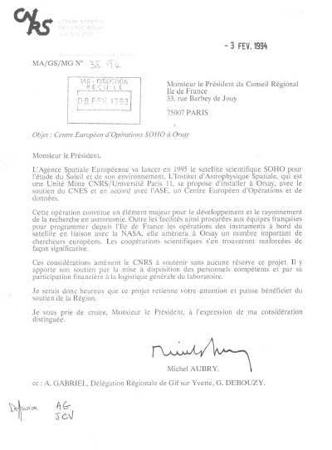
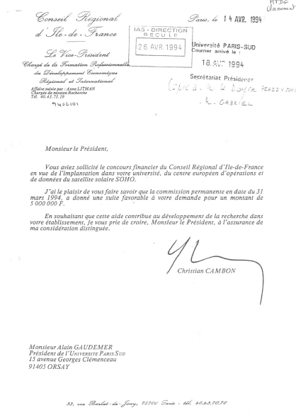
From ESDOC to MEDOC : a long road (3)
5 MFrancs

Slide 13
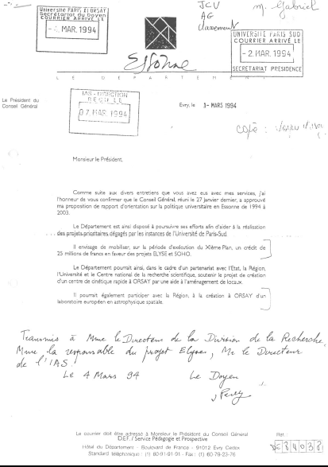
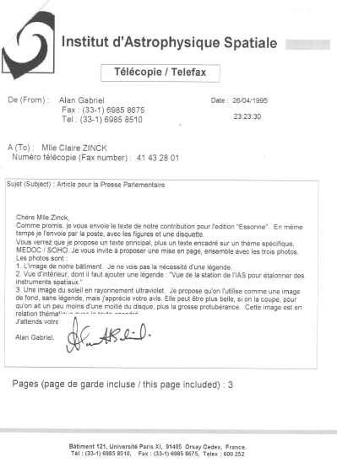
From ESDOC to MEDOC : a long road (4)

Slide 14
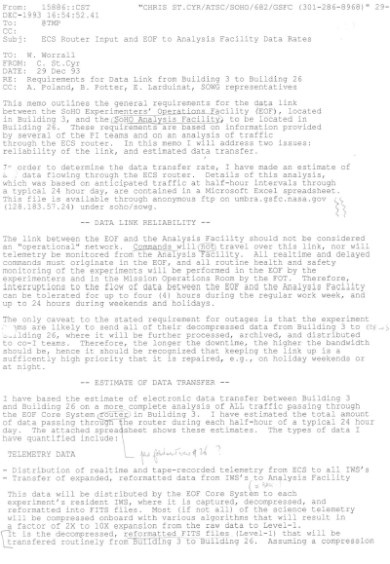
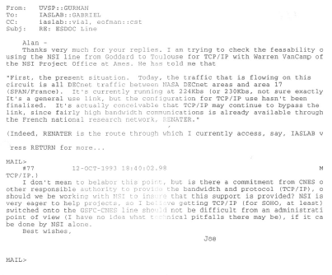
From ESDOC to MEDOC : a long road (5) The support of our friends across the Atlantic : Joe Gurman, Chris Saint-Cyr

Slide 15
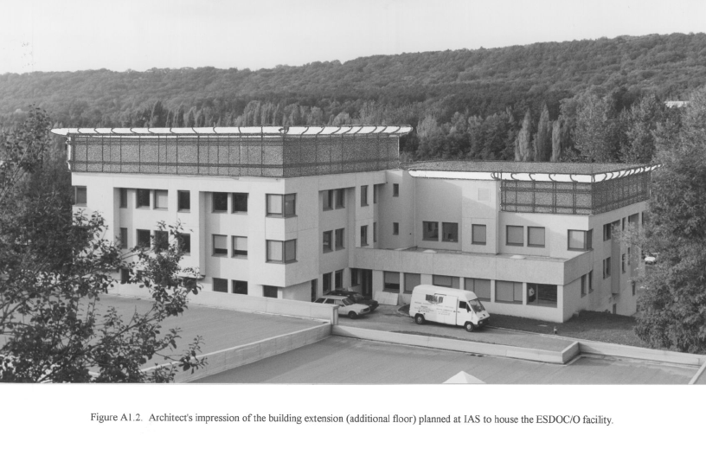
MEDOC: the building (1)

Slide 16
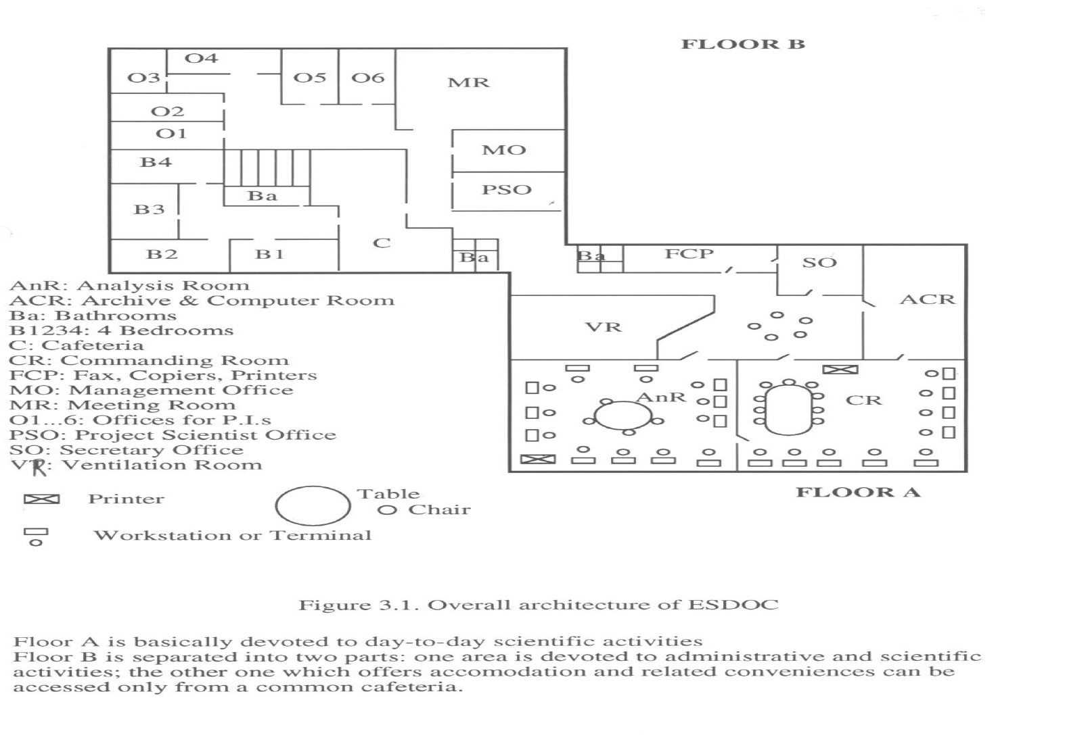
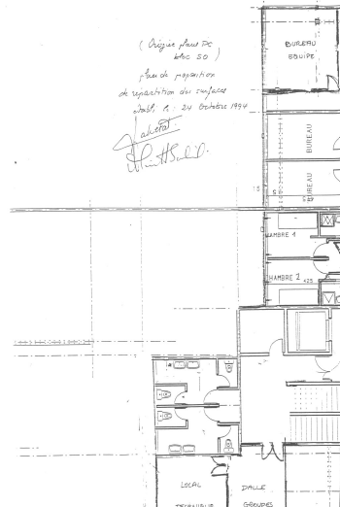
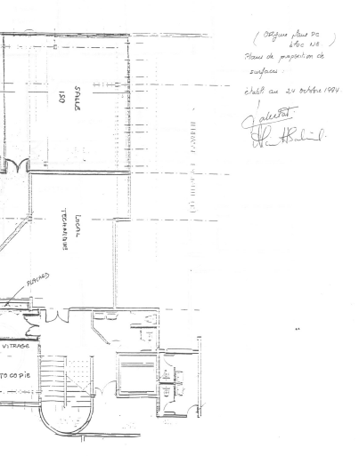
MEDOC: the building (2)
ESDOC MEDOC

Slide 17
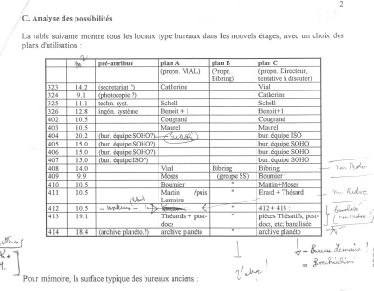
MEDOC: the building (3) : the difficult allocations ….

Slide 18
MEDOC: today
SOHO :
Receiving the full TM
Operations of GOLF, SUMER and CDS as long as SUMER was fully operationnal
Campaigns
Workshops
Database
Archive
SOHO, TRACE, CORONAS, STEREO and now SDO database
Data analysis software : FESTIVAL, UV Atlas, Solar Wind code, Radiative transfer code, Maps of DEM, …

Slide 19
Conclusion
A few lessons from Alan about the MEDOC story :
Evaluate thoroughly the pros and cons of your project
Build a network of supporters/friends/allies/advisers
With the authorities (les « instances »), relently address
the top level
Be persistent, resilient, even stubborn, since you think you are
right : never take « no » for an answer !
Go deep even in the details (since this is where the devil is …)
In summary :
« Where there is the will, there is the way »!

